Slide 1
3D-DMM (pure DMM)

Slide 2

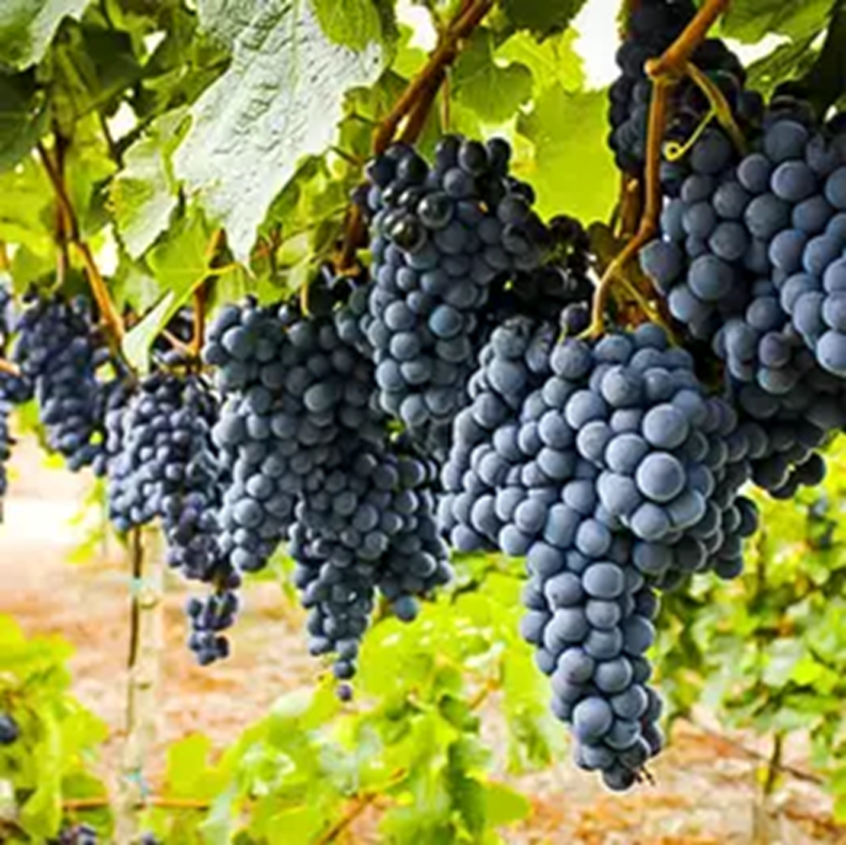
Yohn 15:1-17
What characterizes the fruit God wants?

Slide 3

3D = wide-deep-long
I’m bored with 1 and 2D!

Slide 4


So, what should be #1?
Quality! But how?
  *Train & teach for maturity
  *Train our disciples to be trainers
  *Make leaders from the beginning
  *Create an open and transparent culture
  *Keep working on tactics; don’t stay stuck
© New Generations 2024

Slide 5

the dmm process
What is it a spiral?
What’s the difference between a method and a strategy?
What must be different in every place? What stays the same?
Has this become your way of life? In what ways yes / no?

Slide 6
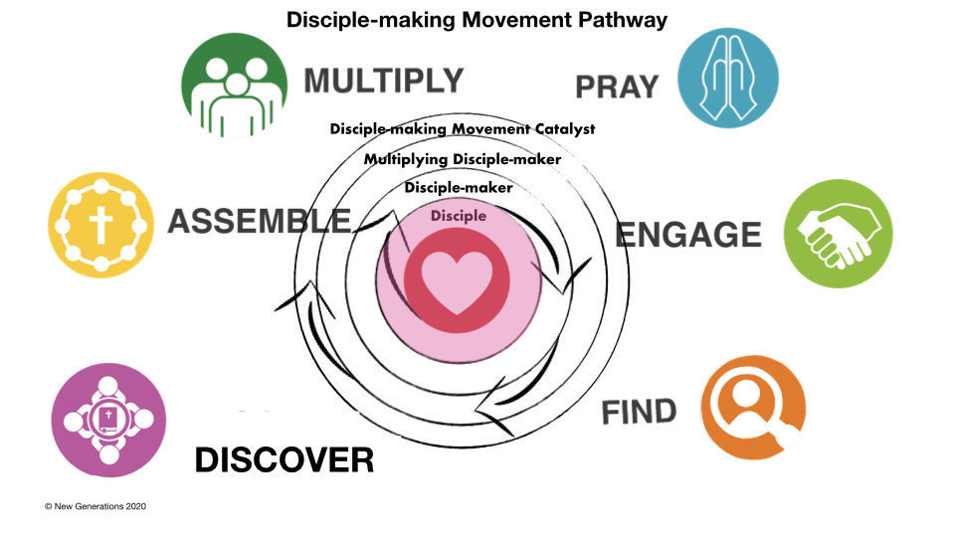
levels

Slide 7
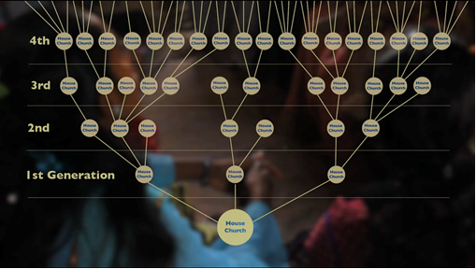
Dmm desired outcome

Slide 8
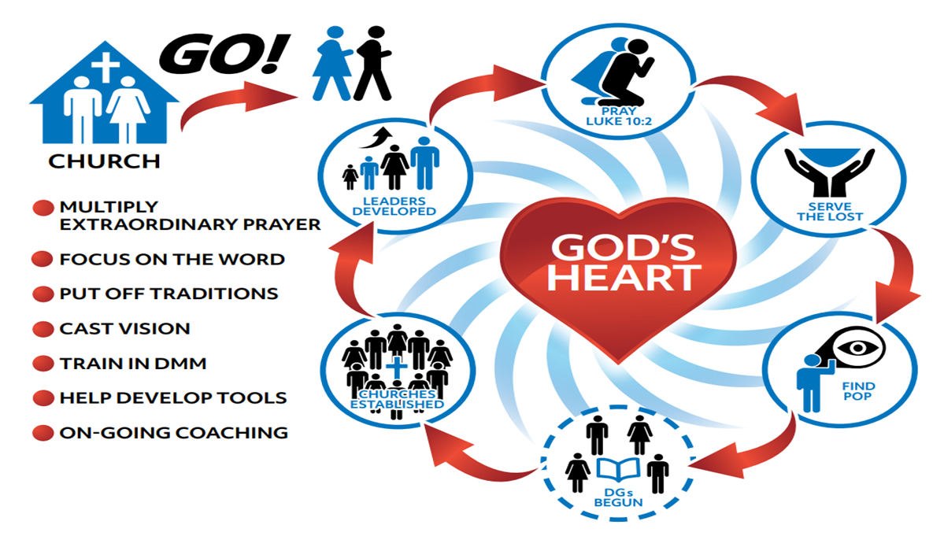
How do we relate to the regular churches?
Avenue 1 avenue 2

Slide 9
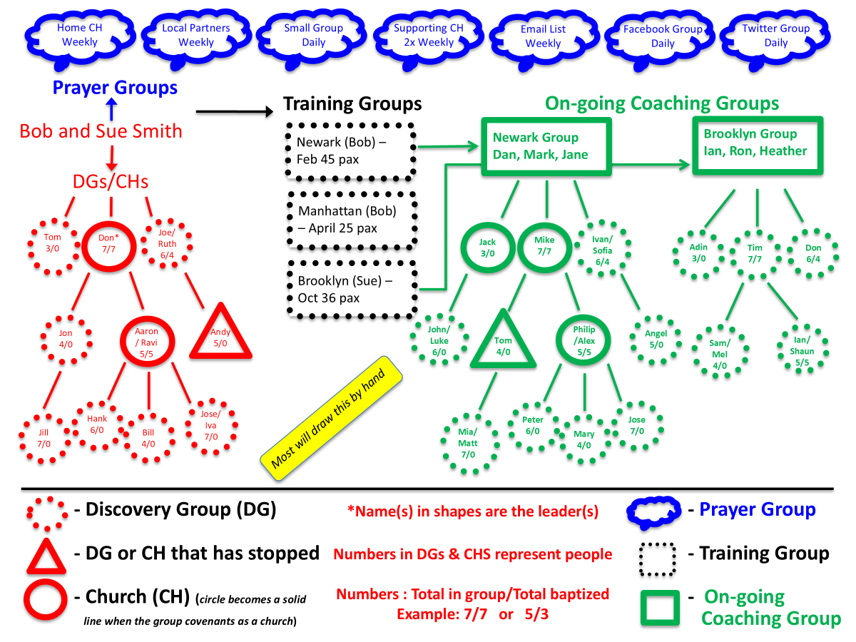
Tracking results

Slide 10
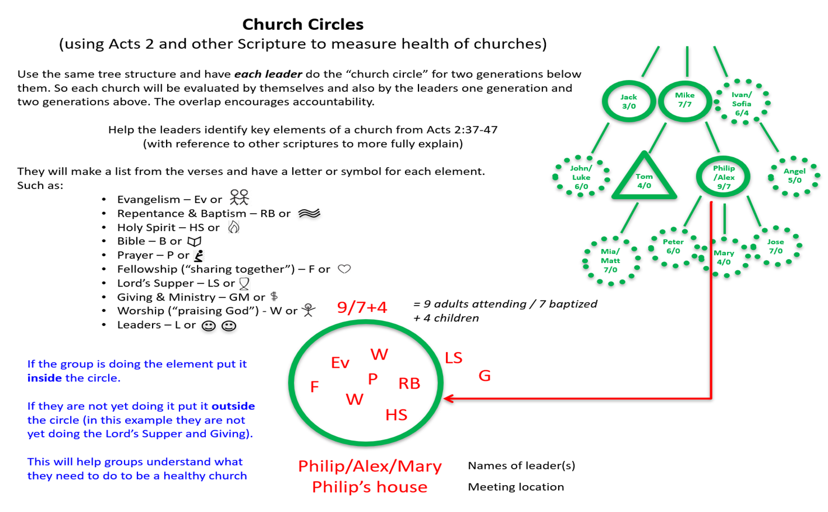
Inspecting the fruit

Slide 11
Peer coaching at every level
G4 Leaders
G3 Leaders
G2 Leaders
G1 Leaders
Team or Gen 0 House church

Slide 12
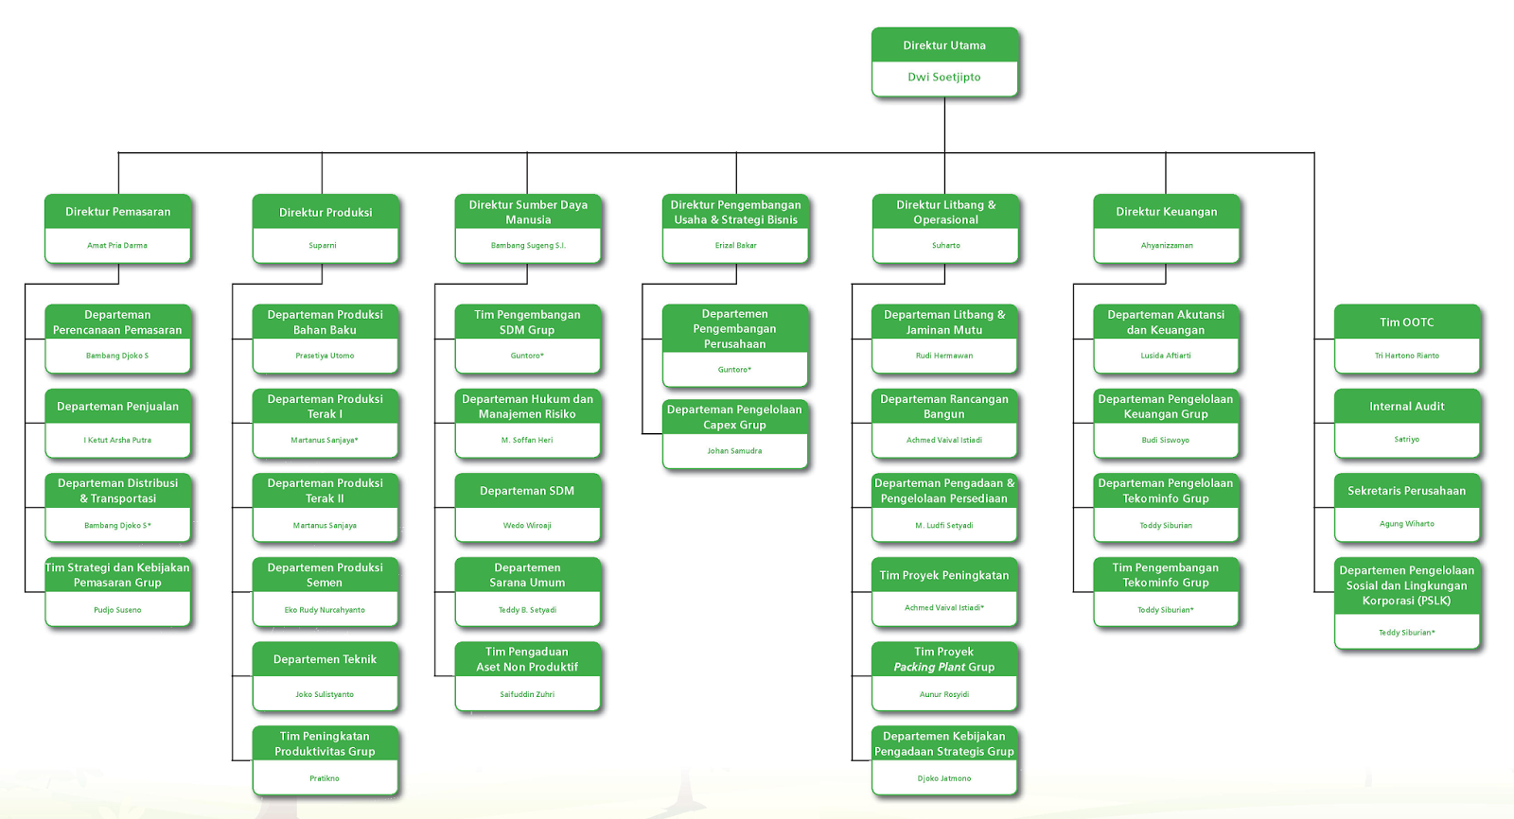
It will take structure
But not normal structure!

Slide 13
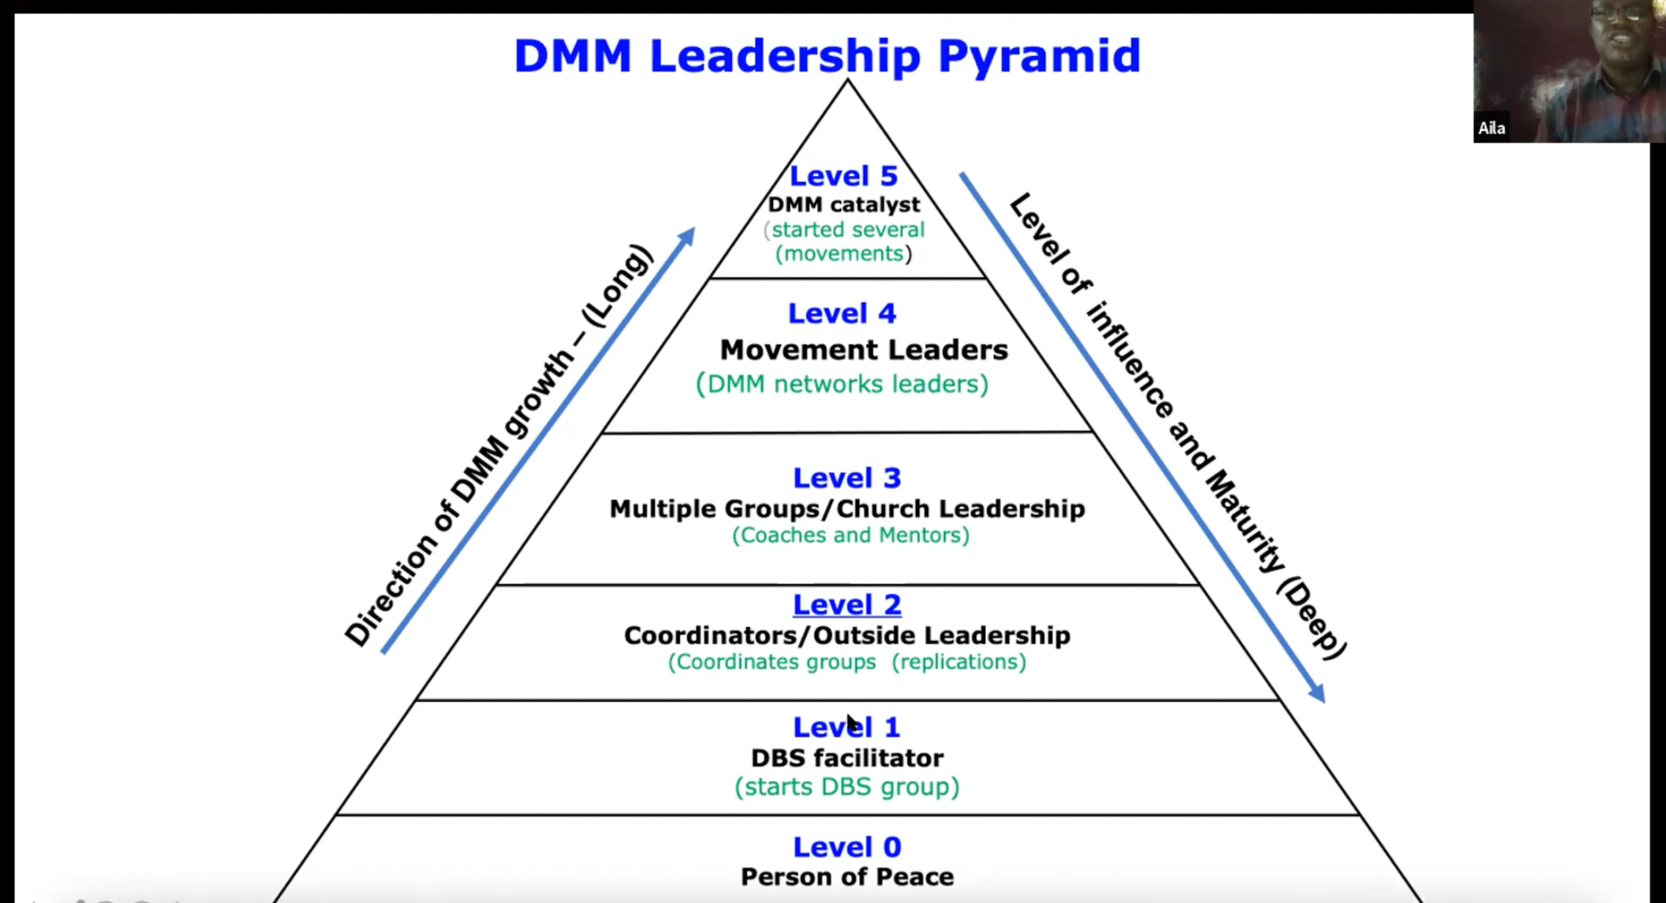
Dr. Aila tasse, Kenya
Notes:
Aila Tasse of Kenya

Slide 14
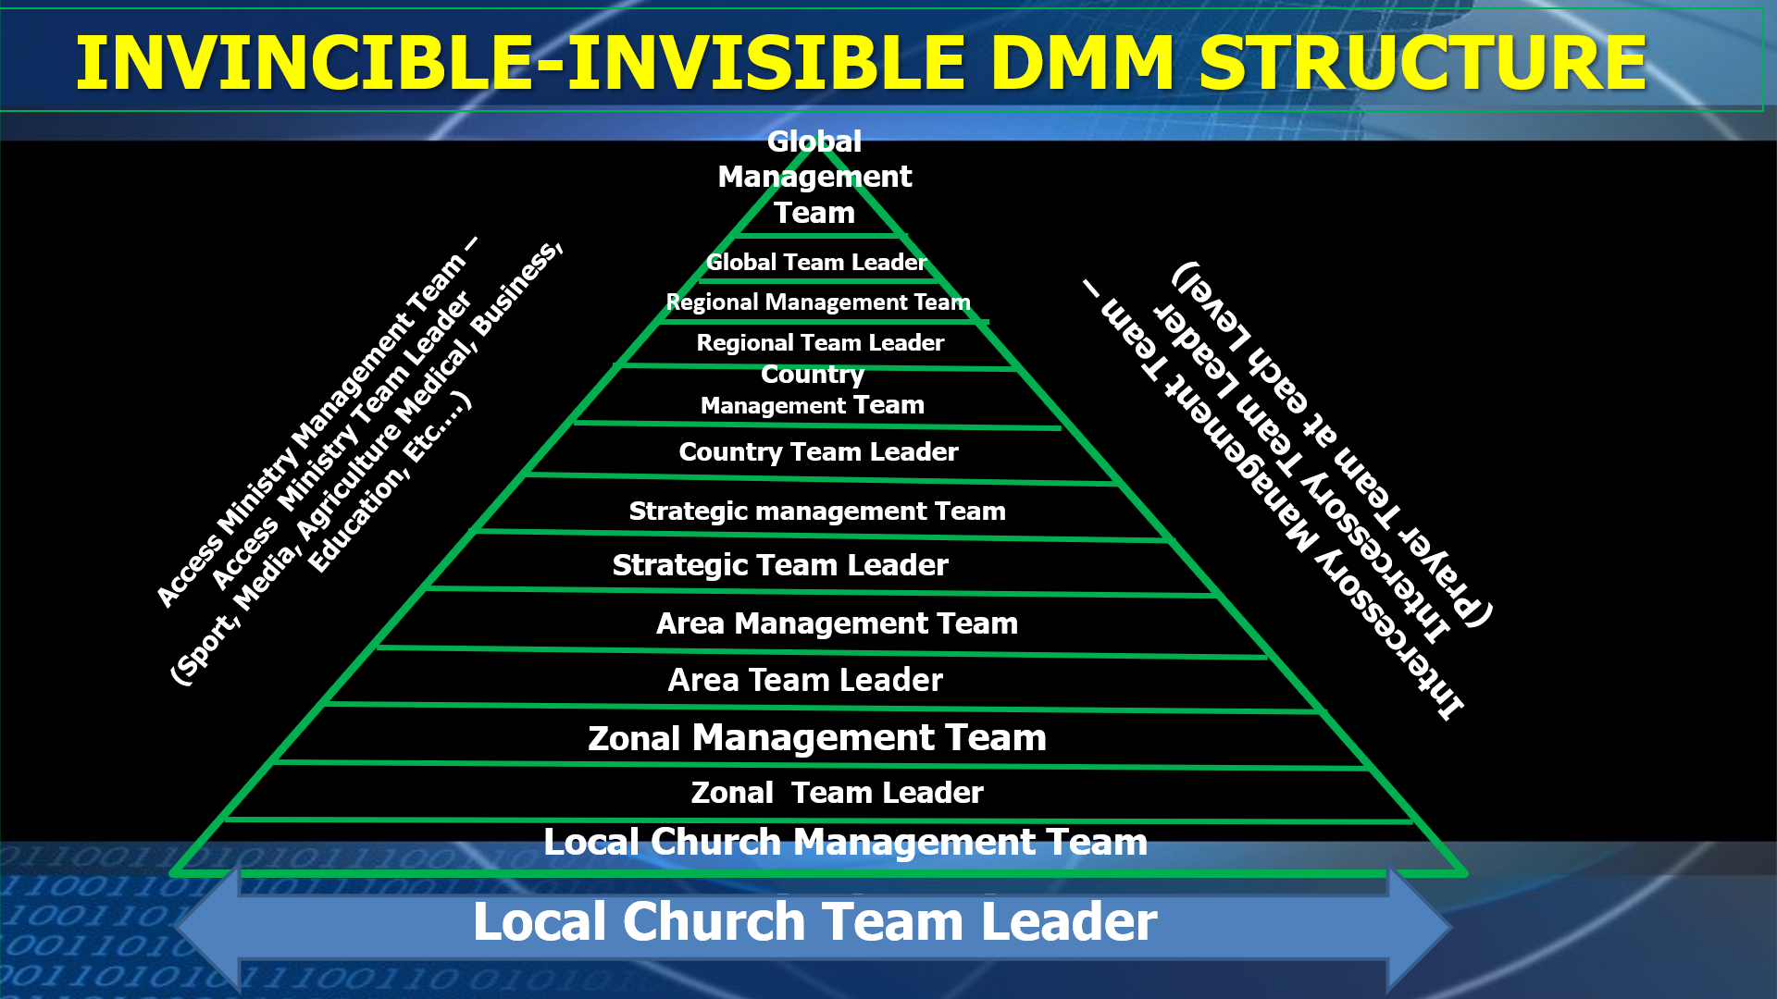
Rev. Shodankeh Johnson, Sierra Leone
Notes:
Shodankeh Johnson of Sierra Leone

Slide 15


Marzuki model

Slide 16


Slide 17

Don’t forget about prayer!

Slide 18
PRAYER STRUCTURE WITHIN ANGLOPHONE West Africa
Sends out national prayer request, organize national prayer retreats, conferences and programs.
Receive reports and collate them,
Note!!
At each level there are teams of intercessors with different team leaders.
National Prayer Movement.
Disciplining Every Disciple to Pray
(Through Couching and Mentoring)
Creating Prayer Movement at
Each Level
Every Country – Country Prayer Movement
Every District – District Prayer Movement
Every Area – Area Prayer Movement
Every Zone – Zonal Prayer Movement
Every Church Plant – Prayer Movement
Every Disciple An Intercessor

Slide 19
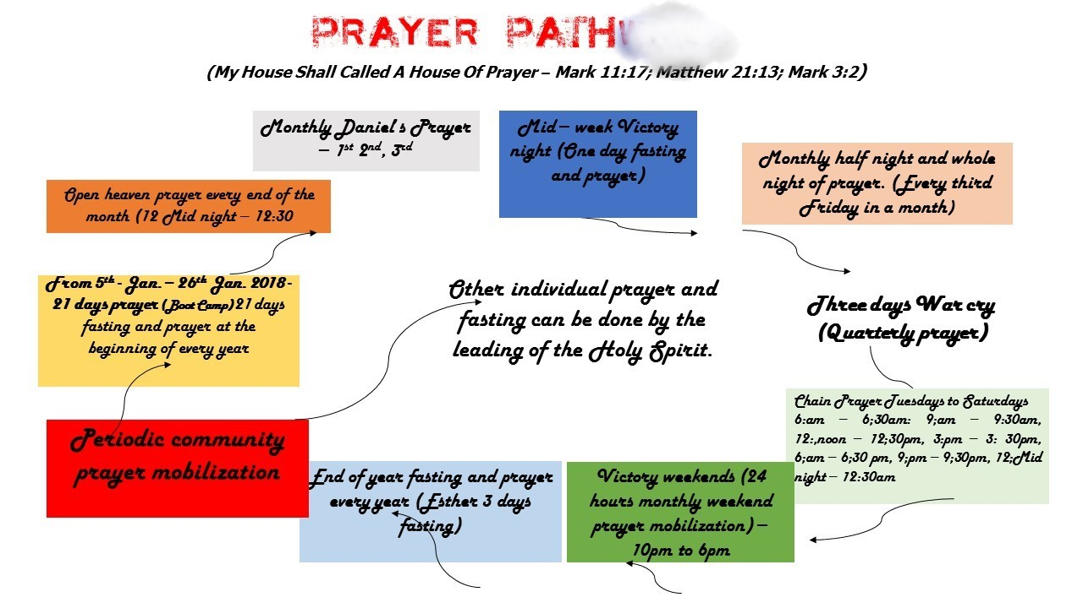
Calendar do’a

Slide 20


So is all this disconnected from the rest of the church?

Slide 21
L10 Indonesia
A network for DMM organizations
So we stay consistent and pure in DMM
So no one is left behind
To reach every segment of Indonesia

Slide 22
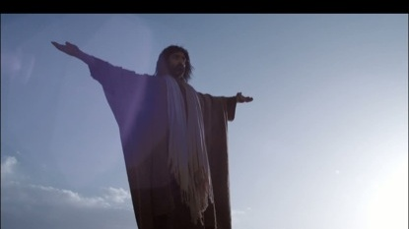

All praise to Jesus!

